Slide 1
Chapter 6: Using Job Control Language (JCL) and System Display and Search Facility (SDSF)

Slide 2
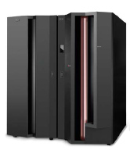
Chapter objectives
Be able to:
Explain how JCL works with the system, give an overview of JCL coding techniques, and know a few of the more important statements and keywords
Create a simple job and submit it for execution
Check the output of your job through SDSF

Slide 3
Key terms in this chapter
concatenation
DD statement
job control language (JCL)
JOB statement
EXEC statement
job name
procedure (PROC)
record format (RECFM)
system display and search facility (SDSF)
step name
system catalog
system library
utility

Slide 4
What is JCL?
Take screenshot 1
Job control language (JCL) tells the system what program to execute and provides a description of program inputs and outputs.
There are three basic JCL statements:
  JOB statement
  EXEC statement
  DD statement
Notes:
The details of JCL can be complicated but the general concepts are quite simple. Also, a small subset of JCL
accounts for at least 90% of what is actually used. This chapter discusses selected JCL
options.
While application programmers need some knowledge of JCL, the production control
analyst responsible must be highly proficient with JCL, to create, monitor, correct and
re-run the company’s daily batch workload.

Slide 5
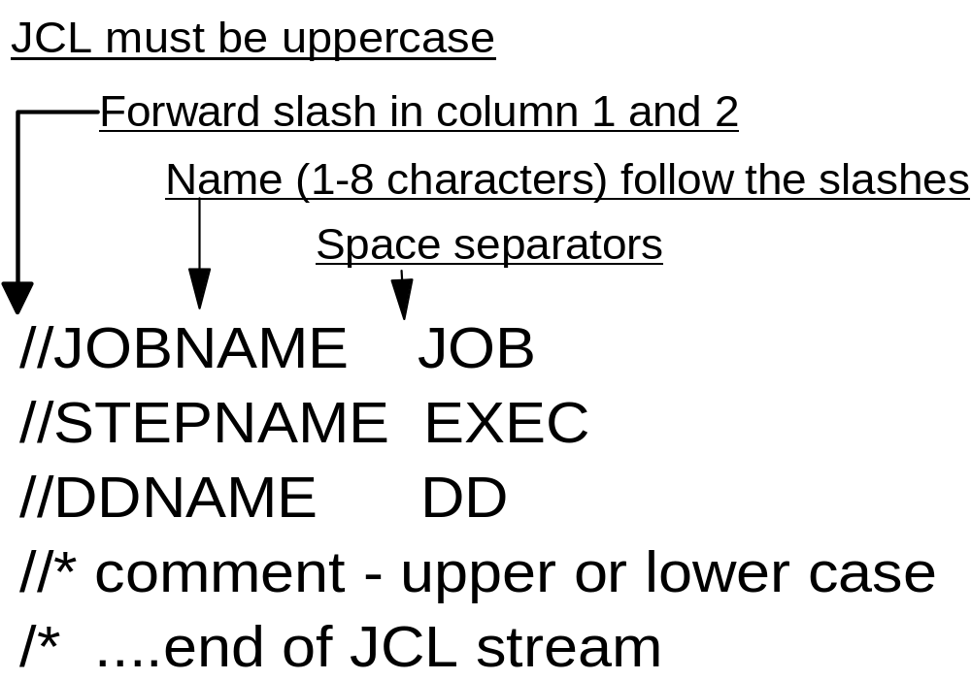
Basic JCL coding syntax
Notes:
There are three basic JCL statements:
JOB Provides a name to the system for this batch workload. It can optionally
include accounting information and a few job-wide parameters.
EXEC Provides the name of a program to execute. There can be multiple EXEC
statements in a job. Each EXEC statement within the same job is a job step.
DD The Data Definition provides inputs and outputs to the execution program
on the EXEC statement. This statement links a data set or other I/O device
or function to a DDNAME coded in the program. DD statements are
associated with a particular job step.

Slide 6
JCL example
//MYJOB JOB 1
//MYSORT EXEC PGM=SORT
//SORTIN DD DISP=SHR,DSN=IBMUSER.AREA.CODES
//SORTOUT DD SYSOUT=*
//SYSOUT DD SYSOUT=*
//SYSIN DD *
SORT FIELDS=(1,3,CH,A)
/*
Notes:
In Chapter 3, “TSO/E, ISPF, and UNIX: Interactive facilities of z/OS” , we executed the
same routine from the TSO READY prompt. Each JCL DD statement is equivalent to the
TSO ALLOCATE command. Both are used to associate a z/OS data set with a ddname,
which is recognized by the program as an input or output. The difference in method of
execution is that TSO executes the sort in the foreground while JCL is used to execute
the sort in the background, or batch.

Slide 7
In the preceding example…
MYJOB Job name
MYSORT Step name
SORTIN DD name for program input
SORTOUT DD name for program output
SYSOUT Where to send system output messages (such as a data set)
SYSIN Specifies whether the input will be data or control statements.
Notes:
When submitted for execution:
MYJOB Is a job name the system associates with this workload.
MYSORT Is the stepname, which instructs the system to execute the SORT
program.
SORTIN On the DD statement, this is the ddname. The SORTIN ddname is
coded in the SORT program as a program input. The data set name
(DSN) on this DD statement is ZPROF.AREA.CODES. The data set can
be shared (DISP=SHR) with other system processes. The data content
of ZPROF.AREA.CODES is SORT program input.
SORTOUT This ddname is the SORT program output.
SYSOUT SYSOUT=* specifies to send system output messages to the Job Entry
Subsystem (JES) print output area. It is possible to send the output to a
data set.
SYSIN DD * is another input statement. It specifies that what follows is data or
control statements. In this case, it is the sort instruction telling the
SORT program which fields of the SORTIN data records are to be
sorted.
We use JCL statements in this text; some z/OS users use the older term JCL card, even
though the JCL resides in a disk library.

Slide 8
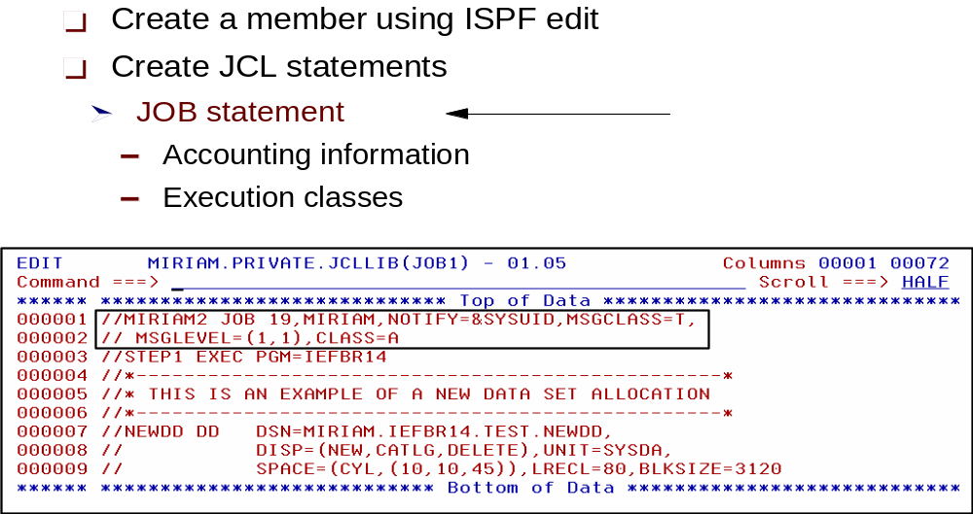
JCL: JOB statement
Notes:
JOB JCL statement //MYJOB JOB 1 is a job card with name MYJOB. The 1 is a job card
accounting field that can be subject to system exits that might be used for charging
system users. Some common JOB card operands that could be included are:
REGION= Value requesting specific memory resources allocated to this job
NOTIFY= Message can be sent to a TSO user ID, following job completion
USER= Job will assume the authority of the user ID specified
TYPRUN= It is possible to submit the job on HOLD, to be released later
CLASS= Direct job JCL statement to a specific input queue, installation
specific
MSGCLASS= Direct job output to a specific output queue, installation specific
MSGLEVEL= Controls amount of system message to be received
Example:
//MYJOB JOB 1,NOTIFY=&SYSUID,REGION=6M

Slide 9
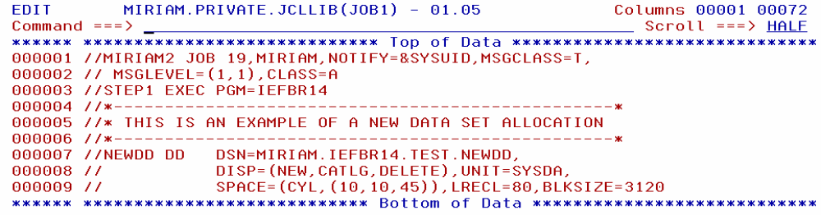
JCL: EXEC statement
EXEC statement
Region size
Notes:
The EXEC JCL statement //MYSTEP EXEC has a stepname of MYSTEP. Following the
EXEC is either PGM=(executable program name) or a JCL PROC name. When a JCL
PROC is present, then the operands will be the variable substitutions required by the JCL
PROC. Common operands found on the EXEC PGM= statement are:
PARM= Parameters known by and passed to the program.
COND= Boolean logic for controlling execution of other EXEC steps in this
job....IF, THEN, ELSE JCL statements exist that are superior to using
COND, however, lots of old JCL may exist in production environments
using this statement.
TIME= Imposes a time limit.
Example:
//MYSTEP EXEC PGM=SORT

Slide 10
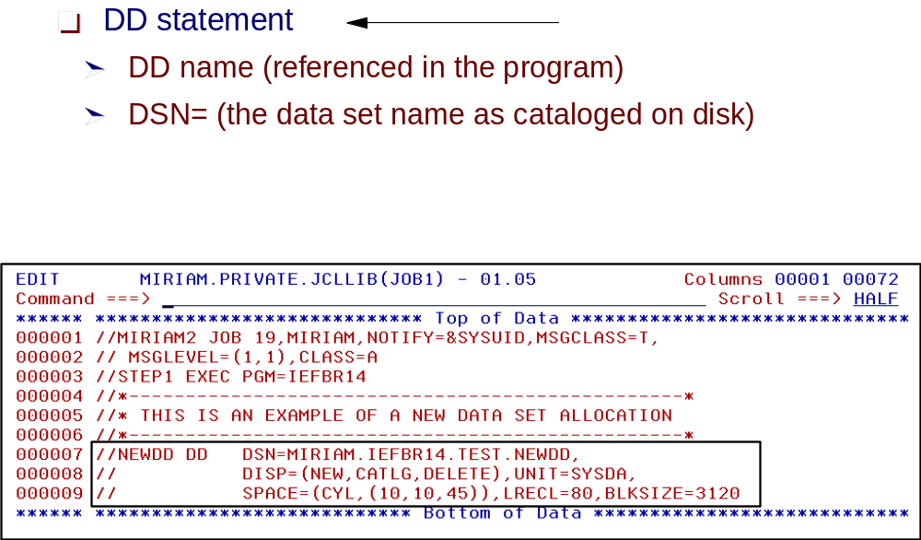
JCL: DD statement
Notes:
The DD JCL statement //MYDATA DD has a ddname of MYDATA.
DD, the Data Definition, has significantly more operands than the JOB or EXEC
statements. The DD JCL statement can be involved with many aspects of defining or
describing attributes of the program inputs or outputs. Some common DD statement
operands are:
DSN= The name of the data set; this can include creation of temporary data
sets or a reference back to the data set name.
DISP= Data set disposition at step start (new, shr, old, mod), at step end (catlg,
keep, delete, pass) and if the step abnormally ends (catlg, keep, delete,
pass).
SPACE= Amount of disk storage requested for a new data set.
SYSOUT= Defines a print location (and the output queue or data set).
VOL=SER= Volume name, disk name or tape name
UNIT= System disk, tape, special device type, or esoteric (local name).
DEST= Routes output to a remote destination.
DCB= Data set control block, numerous sub operands.
Most common suboperands:
LRECL= Logical record length. Number of bytes/characters in each
record.
RECFM= Record format, fixed, blocked, variable, etc.
BLOCKSIZE= Store records in a block of this size, typically a multiple of
LRECL. A value of 0 will let the system pick the best value.
DSORG= Data set organization—sequential, partitioned, etc.
LABEL= Tape label expected (No Label or Standard Label followed by data set
location). A tape can store multiple data sets; each data set on the tape
is in a file position. The first data set on tape is file 1.
DUMMY Results in a null input or throwing away data written to this ddname.
* Input data or control statements follow—a method of passing data to a
program from the JCL stream.
*,DLM= Everything following is data input (even //) until the two alphanumeric
or special characters specified are encountered in column 1.

Slide 11
Specifying a data set disposition:
DISP is an operand of the DD statement
DISP indicates what to do with the data set (the disposition) at step start, end, or abnormal end (if the job fails)
DISP helps to prevent unwanted simultaneous access to data sets, which is very important for general system operation.

Slide 12
Uses of the DISP= operand
DISP=(status,normal end,abnormal end)
DISP=(status,normal end)
DISP=status
where status can be
  NEW
  OLD
  SHR
  MOD
Notes:
All JCL parameters are important, but the DISP function is perhaps the most important
for DD statements. The complete parameter has these fields:
DISP= (status,normal end,abnormal end)
DISP= (status,normal end)
DISP= status
where status can be NEW, OLD, SHR, or MOD:
NEW Indicates that a new data set is to be created. This job has exclusive access to
the data set while it is running. The data set must not already exist.
OLD Indicates that the data set already exists and that this job is to have exclusive
access to it while it is running.
SHR Indicates that the data set already exists and that several concurrent jobs can
share access while they are running. All the concurrent jobs must specify
SHR.
MOD Indicates that the data set already exists and the current job must have
exclusive access while it is running. If the current job opens the data set for
output, the output will be appended to the current end of the data set.
The normal end parameter indicates what to do with the data set (the disposition) if the
current job step ends normally. Likewise, the abnormal end parameter indicates what to
do with the data set if the current job step abnormally ends.
The options are the same for both parameters:
DELETE Means to delete (and uncatalog) the data set at the end of the job step.
KEEP Means to keep (but not catalog) the data set at the end of the job step.
CATLG Means to keep and catalog the data set at the end of the job step.
UNCATLG Means to keep the data set but uncatalog it at the end of the job step.
PASS Means to allow a later job step to specify a final disposition.
The default disposition parameters (for normal and abnormal end) are to leave the data
set as it was before the job step started. (The catalog function was described previously.)
A main purpose of the DISP parameter is to advise the system about data set enqueuing
needed for this job to prevent conflicting use of the data set by other jobs.

Slide 13
Creating a new data set
New data sets can be created through JCL by using the DISP=NEW parameter.
For a DISP=NEW request, you need to supply more information, including:
  A data set name, DSN=
  The type of device for the data set, UNIT=sysda
  If a disk is used, the amount of space to be allocated for the primary extent must be specified, SPACE=
  If it is a partitioned data set, the size of the directory must be specified within the SPACE parameter
  Optionally, DCB parameters can be specified.
Notes:
If the DISP parameter for a data set is NEW, then additional information is needed. This
includes:
A data set name.
The type of device for the data set.
A volser if it is a disk or labeled tape.
If a disk is used, the amount of space to be allocated for the primary extent must be
specified.
If it is a partitioned data set, the size of the directory must be specified.
Optionally, DCB parameters can be specified. Alternately, the program that will write
the data set can provide these parameters.
The DISP and data set names have already been described. Briefly, the other parameters
are:
Volser The format for this in a DD statement is VOL=SER=xxxxxx, where
xxxxxx is the volser. The VOL parameter can specify other details,
which is the reason for the format.
Device type There are a number of ways to do this, but UNIT=xxxx is the most
common. The xxxx can be an IBM device type (such as 3390), or a
specific device address (such as 300), or an esoteric name defined by
the installation (such as SYSDA). A common convention uses
SYSDA to represent any available disk volume.
Member name Remember that a library (or partitioned data set, PDS) member can
be treated as a data set by many applications and utilities. The format
DSNAME=ZPROF.LIB.CNTL(TEST) is used to reference a specific
member. If the application or utility program is expecting a
sequential data set, then either a sequential data set or a member of a
library must be specified. A whole library name (without a specific
member name) can be used only if the program or utility is expecting a
library name.
Space:
The SPACE DD parameter is required for allocating data sets on DASD. It identifies the
space required for your data set. Before a data set can be created on disk, the system must
know how much space the data set requires and how the space is to be measured.
In the basic case, SPACE has two parameters. These are the unit of measure and the
amount of space. The unit of measure can be tracks, cylinders, or the average block size.

Slide 14
Continuation and concatenation
Needed to overcome the limitations of the 80-column punched cards used in earlier systems.
  Continuation allows a JCL statement to span multiple records.
  Concatenation allows a single ddname to have multiple DD statements.
Notes:
As a consequence of the limitations of the number of characters that could be contained
in single 80-column punched cards used in earlier systems, z/OS introduced the concepts
of continuation and concatenation. Therefore, z/OS retained these conventions in order to
minimize the impact on previous applications and operations.

Slide 15
Continuation and concatenation (example)
Continuation example
//JOBCARD JOB 1,
// REGION=8M,
// NOTIFY=IBMUSER
Concatenation example
//DATAIN DD DISP=OLD,DSN=MY.INPUT1
// DD DISP=OLD,DSN=MY.INPUT2
// DD DISP=SHR,DSN=YOUR.DATA
Notes:
Continuation of JCL syntax involves a comma at the end of the last complete operand.
The next JCL line would include // followed by at least one space, then the additional
operands. JCL operand syntax on a continuation line must begin on or before column
sixteen.
//JOBCARD JOB 1,REGION=8M,NOTIFY=ZPROF
An important feature of DD statements is the fact that a single ddname can have multiple
DD statements. This is called concatenation.
The following JCL indicates that data sets are concatenated:
//DATAIN DD DISP=OLD,DSN=MY.INPUT1
// DD DISP=OLD,DSN=MY.INPUT2
// DD DISP=SHR,DSN=YOUR.DATA
Concatenation applies only to input data sets. The data sets are automatically processed
in sequence. In the example, when the application program reads to the end of
MY.INPUT1, the system will automatically open MY.INPUT2 and start reading it. The
application program is not aware that it is now reading a second data set. This continues
until the last data in the concatenation is read; at that time the application receives an
end-of -file indication.

Slide 16
JCL procedures - example
//MYJOB JOB 1
//MYPROC PROC
//MYSORT EXEC PGM=SORT
//SORTIN DD DISP=SHR,DSN=&SORTDSN
//SORTOUT DD SYSOUT=*
//SYSOUT DD SYSOUT=*
// PEND
Notes:
Some programs and tasks require a larger amount of JCL than a user can easily enter.
JCL for these functions can be kept in procedure libraries. A procedure library member
contains part of the JCL for a given task -- usually the fixed, unchanging part of JCL.
The user of the procedure supplies the variable part of the JCL for a specific job.
Such a procedure is sometimes known as a cataloged procedure. A cataloged procedure
is not related to the system catalog.
Much of this JCL should be recognizable now. New JCL functions presented here
include:
PROC and PEND statements are unique to procedures. They are used to identify the
beginning and end of the JCL procedure.
The PROC is preceded by a label or name; the name defined in the example on the slide is MYPROC.
JCL variable substitution is the reason JCL PROCs are used. &SORTDSN is the only
variable in this example.

Slide 17
JCL procedures (continued)
//MYJOB JOB 1
//*---------------------------------*
//MYPROC PROC
//MYSORT EXEC PGM=SORT
//SORTIN DD DISP=SHR,DSN=&SORTDSN
//SORTOUT DD SYSOUT=*
//SYSOUT DD SYSOUT=*
// PEND
//*---------------------------------*
//STEP1 EXEC MYPROC,SORTDSN=IBMUSER.AREA.CODES
//SYSIN DD *
SORT FIELDS=(1,3,CH,A)
Notes:
In this example, we include the inline procedure from the previous slide in our job stream.
When MYJOB is submitted, the JCL from the example on the previous slide is effectively
substituted for EXEC MYPROC. The value for &SORTDSN must be provided.
SORTDSN and its value were placed on a separate line, a continuation of the EXEC
statement. Notice the comma after MYPROC.
//SYSIN DD * followed by the SORT control statement will be appended to the
substituted JCL.

Slide 18
JCL procedures -- statement override
//MYJOB JOB 1
//*---------------------------------*
//MYPROC PROC
//MYSORT EXEC PGM=SORT
//SORTIN DD DISP=SHR,DSN=&SORTDSN
//SORTOUT DD SYSOUT=*
//SYSOUT DD SYSOUT=*
// PEND
//*---------------------------------*
//STEP1 EXEC MYPROC,SORTDSN=IBMUSER.AREA.CODES
//MYSORT.SORTOUT DD DSN=IBMUSER.MYSORT.OUTPUT,
// DISP=(NEW,CATLG),SPACE=(CYL,(1,1)),
// UNIT=SYSDA,VOL=SER=SHARED,
// DCB=(LRECL=20,BLKSIZE=0,RECFM=FB,DSORG=PS)
//SYSIN DD *
SORT FIELDS=(1,3,CH,A)
Notes:
When an entire JCL PROC statement needs to be replaced, then a JCL PROC override
statement can be used. An override statement has the following form:
//stepname.ddname DD ...
This slide shows an example of overriding the SORTOUT DD statement in MYPROC.
Here, SORTOUT is directed to a newly created sequential data set.

Slide 19
Using SDSF
After submitting a job, z/OS users use System Display and Search Facility (SDSF) to review the job output for successful completion or JCL errors.
SDSF allows users to:
  View and search the system log
  Enter system commands
  Hold, release, cancel, and purge jobs
  Monitor jobs while they are processed
  Display job output before deciding to print it
  Control the order in which jobs are processed
  Control the order in which output is printed
  Control printers and initiators
Notes:
SDSF is a software product whose primary purpose is to display printed output held in the JES
spool area. Much of the printed output sent to JES by batch jobs (and other jobs) is never
actually printed. Instead it is inspected using SDSF and deleted or used as needed.

Slide 20
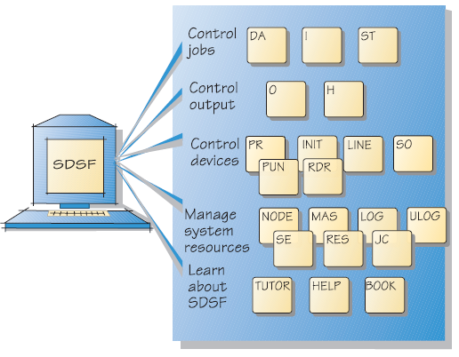
Tasks and SDSF Panels

Slide 21
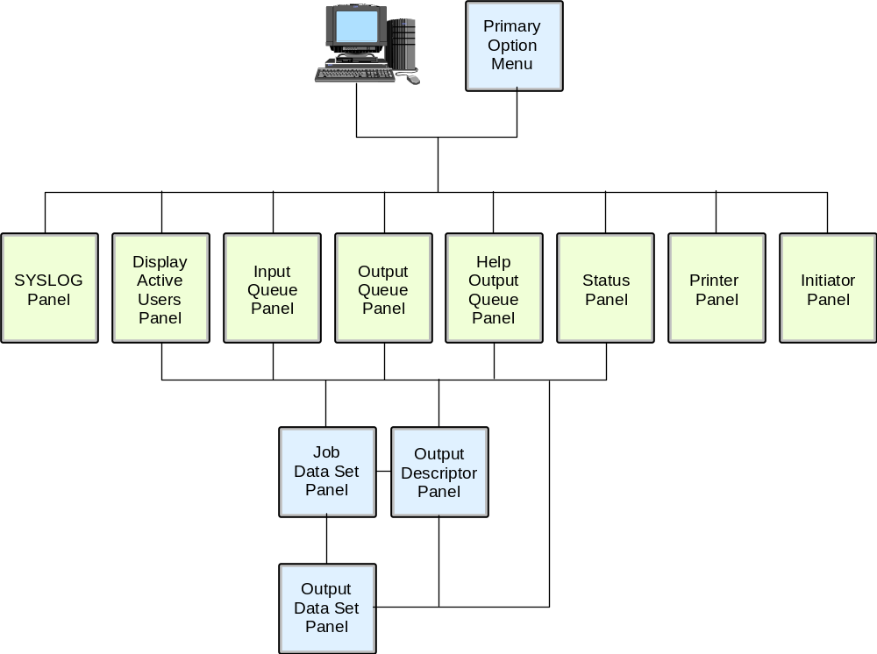
SDSF panel hierarchy

Slide 22
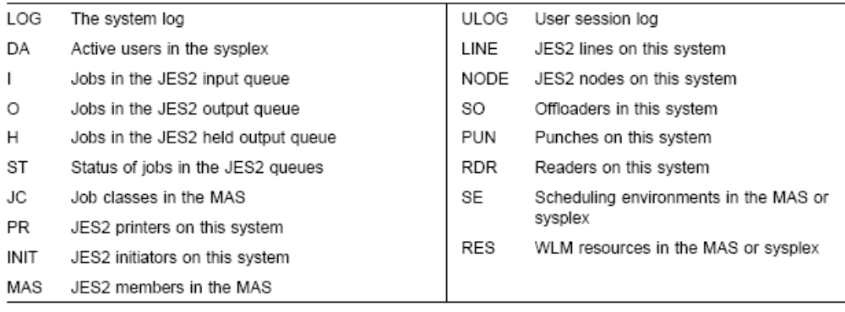

SDSF Panel Names

Slide 23
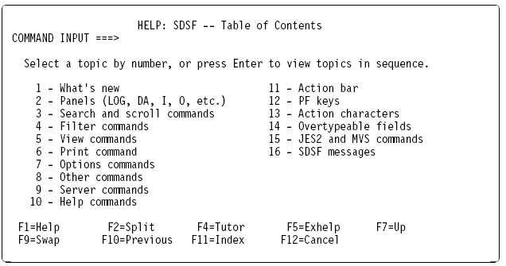

SDSF HELP facility
SDSF

Slide 24
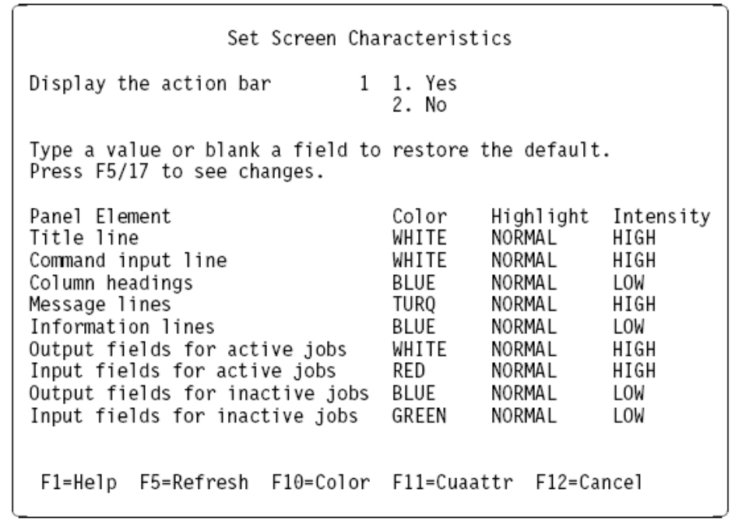

Screen Attributes

Slide 25
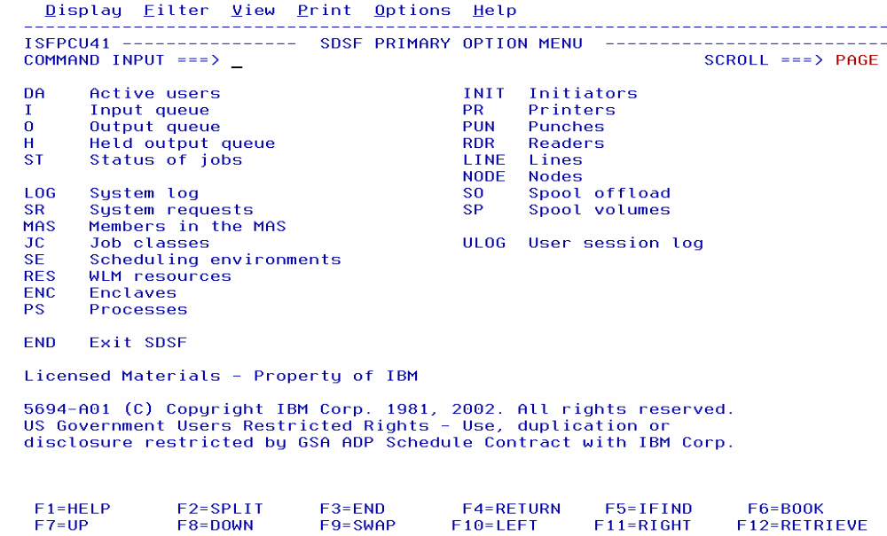
SDSF: Primary option menu
Notes:
This is the SDSF primary options menu. Some of the options shown are:
DA The Display Active panel shows information about MVS address spaces (jobs, started tasks,
and TSO users) that are running.
I The Input Queue panel displays information about jobs, started
tasks, and TSO users on the JES2 input queue or executing.
O The Output Queue panel displays information about SYSOUT data
sets for jobs, started tasks, and TSO users on any nonheld JES2 output queue.
H The Held Output panel shows information about SYSOUT data sets for
jobs, started tasks, and TSO users on any held JES2 output queue.
ST The Status panel displays information about jobs, started tasks,
and TSO users on the JES2 queues.
LOG The system Log panel displays the log and lets you search it.
PS The Processes panel displays information about z/OS UNIX System Services processes.
PR The Printers panel displays information about JES2 printers printing
jobs, started task, and TSO user output.

Slide 26
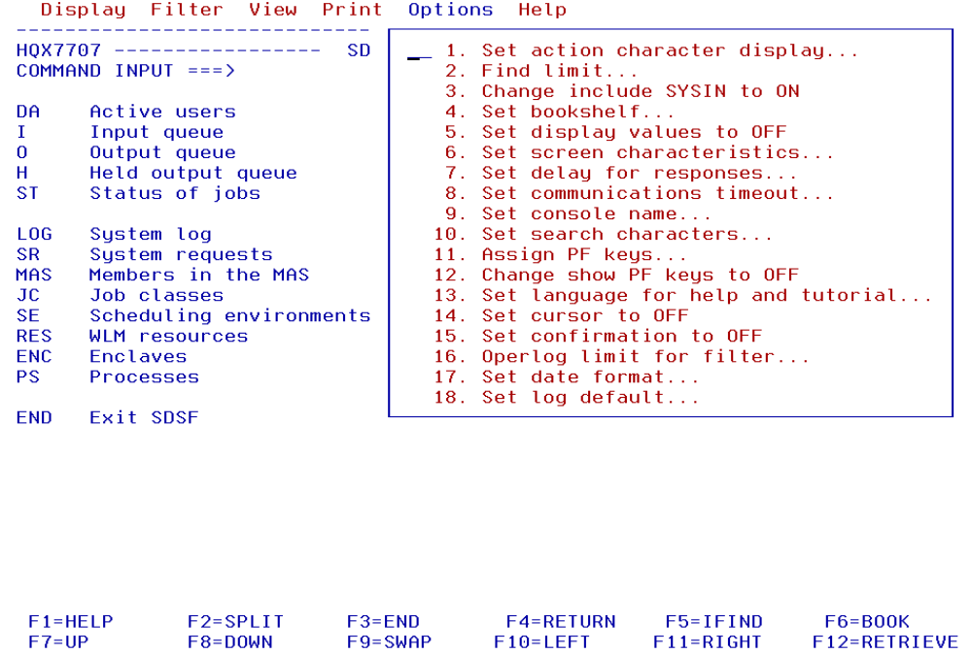
SDSF: Options menu
Notes:
Selecting options from the task bar allows you to tailor the SDSF primary options panel.

Slide 27
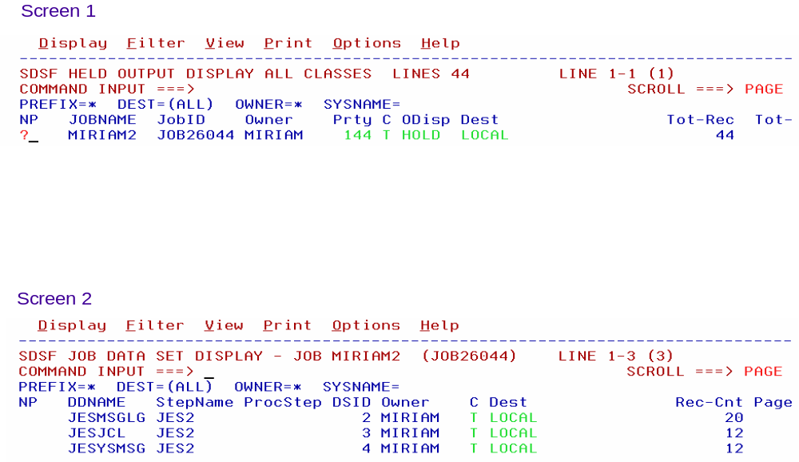
Viewing the JES2 output files
Notes:
The first screen shown on the slide displays a list of the jobs we submitted and whose
output we directed to the HELD (Class T) queue, as identified in the MSGCLASS=T
parameter on the job card. In our case only one job has been submitted and executed.
Therefore, we only have one job on the Held queue.
Issuing a ? command in the NP column displays the output files generated by job 7359.
The second screen displays three ddnames: the JES2 messages log
file, the JES2 JCL file, and the JES2 system messages file. This option is useful when
you are seeing jobs with many files directed to SYSOUT and you want to display one
associated with a specific step. You issue an S in the NP column to select a file you want.
To see all files, instead of a ?, type S in the NP column;

Slide 28
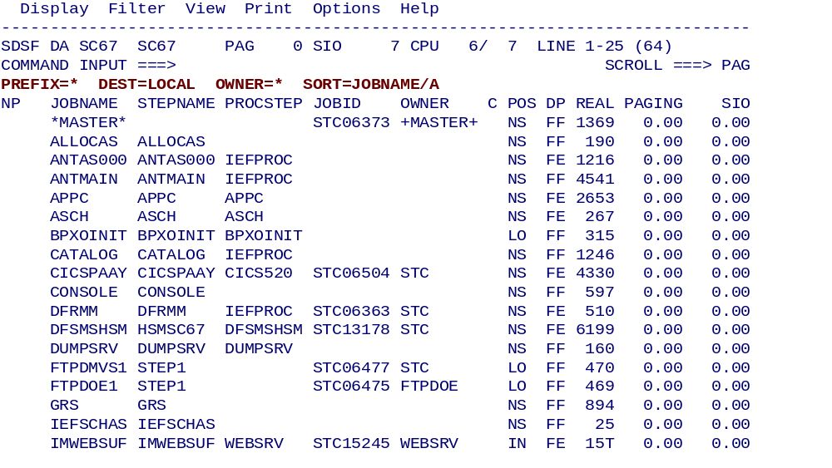
SDSF: Display active users (DA)

Slide 29
SDSF: Display active users (DA) - PREFIX your tsoid*

Slide 30
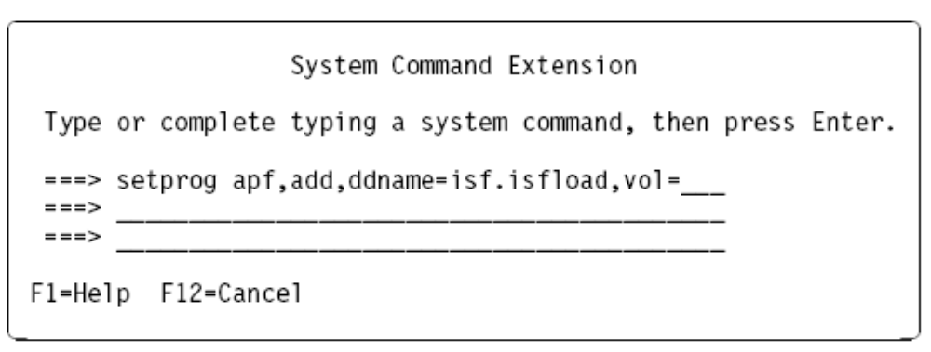
Operator Extension
SDSF DA MVSA DEMOMVS PAG 0 SIO 563 CPU 15/ 15 LINE 1-17 (282)
COMMAND INPUT ===> SCROLL ===> PAGE
/
/d u,dasd,online
/d a,l

Slide 31
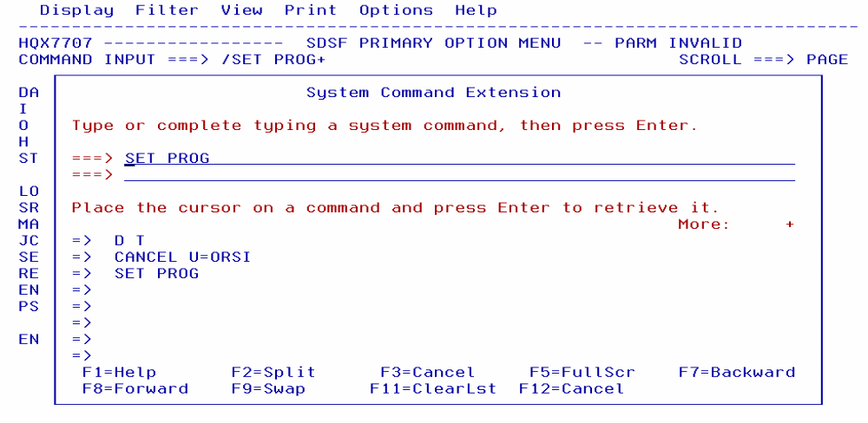
Issuing MVS and JES commands
Note: You have to be in ISPF/SDSF for this option (SDSF can run native in TSO)

Slide 32
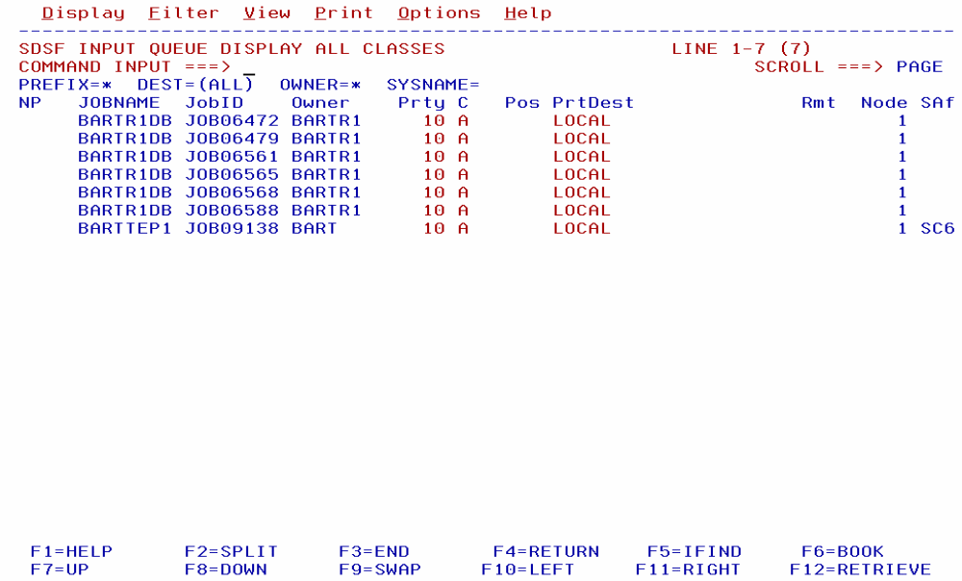
SDSF: Input queue panel

Slide 33
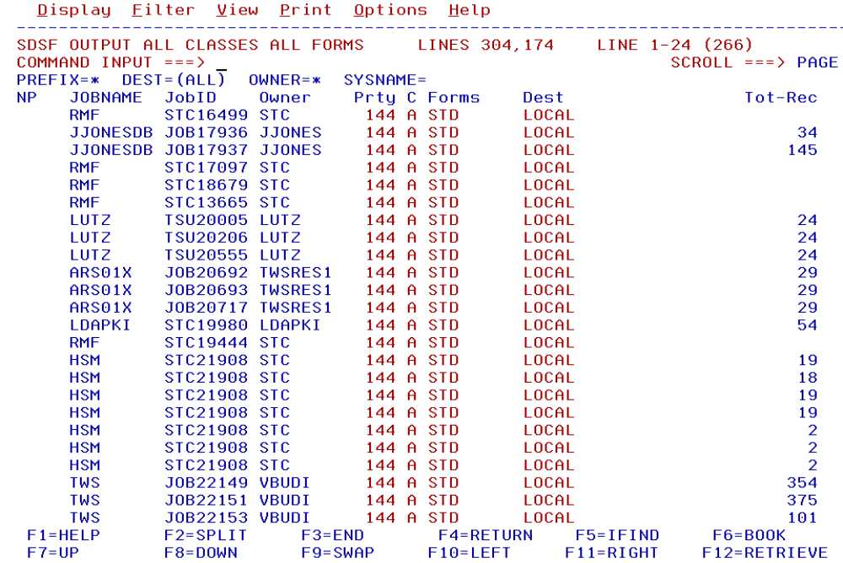
SDSF: Output queue panel

Slide 34
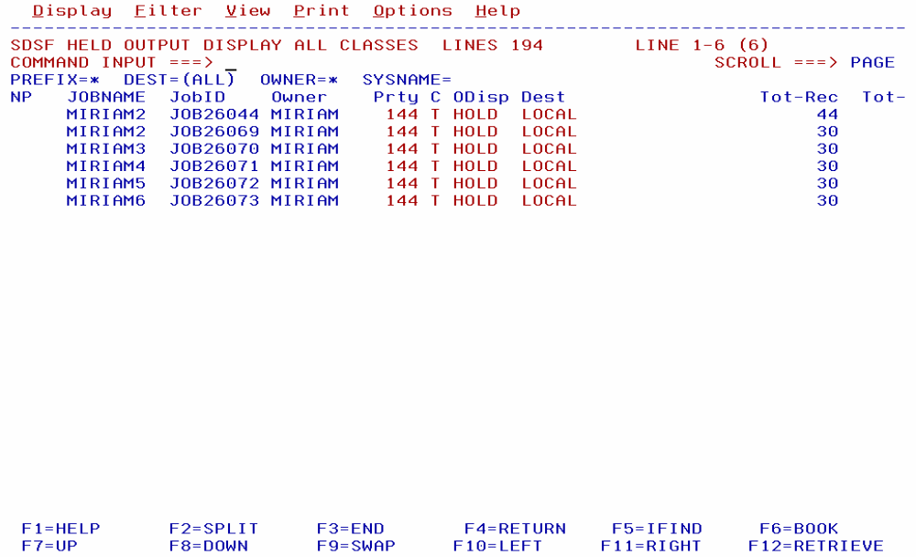
SDSF: Held output queue panel

Slide 35
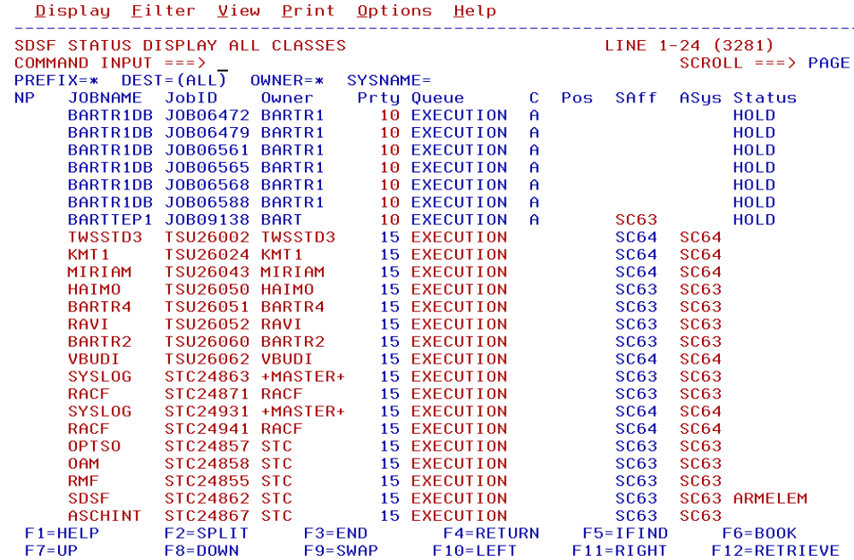
SDSF: Status panel

Slide 36
Utilities
z/OS includes a number of programs useful in batch processing called utilities.
Utilities provide many small, obvious, and useful functions.
A basic set of system-provided utilities is described in the textbook (Appendix C).
Customer sites often write their own utility programs, many of which are shared by the z/OS user community.
Some examples of utilities:
  IEBGENER Copies a sequential data set
  IEBCOPY Copies a partitioned data set
  IDCAMS Works with VSAM data sets

Slide 37
IEBGENER (Sequential Copy / Generate Dataset)
You can use IEBGENER to perform the following tasks:
* Create a backup copy of a sequential data set, a member of a partitioned data set or PDSE or a UNIX system services (USS) file such as a HFS file.
* Produce a partitioned data set or PDSE, or a member of a partitioned data set or PDSE, from a sequential data set or a USS file.
* Expand an existing partitioned data set or PDSE by creating partitioned members and merging them into the existing data set.
* Produce an edited sequential or partitioned data set or PDSE.
* Manipulate data sets containing double-byte character set data.
* Print sequential data sets, members of partitioned data sets or PDSEs or USS files.
* Reblock or change the logical record length of a data set.
* Copy user labels on sequential output data sets.
example
//PRINT JOB ...
//STEP1 EXEC PGM=IEBGENER
//SYSPRINT DD SYSOUT=A
//SYSIN DD DUMMY
//SYSUT1 DD DSNAME=ZUSER01.D80.DATA,DISP=SHR
//SYSUT2 DD SYSOUT=A
//*SYSUT2 DD SYSOUT=T Note: comment card in JCL
Print a sequential
dataset to printer
or back to terminal

Slide 38
IEBCOPY (Library Copy) Utility
IEBCOPY is a data set utility that is used to copy or merge members between one
or more partitioned data sets, or partitioned data sets extended (PDSEs), in full or
in part. You can also use IEBCOPY to create a backup of a partitioned data set into
a sequential data set (called an unload data set or PDSU), and to copy members
from the backup into a partitioned data set.
example
//COMPRESS EXEC PGM=IEBCOPY
//*
//A DD DSNAME=‘ZUSER01.JCL.CNTL',DISP=OLD
//B DD DSNAME=‘ZUSER01.JCL.CNTL',DISP=OLD
//*
//SYSIN DD *
COPY OUTDD=B,INDD=A

Slide 39
VSAM – Access Method Services (IDCAMS)
When you want to use an access method services function, you issue a command and specify its parameters. Your request is decoded, one command at a time, and the appropriate functional routines are then called to perform all services required by that command.
You can invoke the access method services program in three ways:
As a job or job step
From a TSO terminal
From within your own program
You can execute the IDCAMS program and include the command and its parameters as input to the program. You can also call the IDCAMS program from within another program and pass the command and its parameters to the IDCAMS program.
//YOURJOB JOB YOUR INSTALLATION'S JOB=ACCOUNTING DATA
//JOBCAT DD DSNAME=YOUR.CATALOG,DISP=SHR
//STEP1 EXEC PGM=IDCAMS
//STEPCAT DD DSNAME=ANOTHER.CATALOG,DISP=SHR
//SYSPRINT DD SYSOUT=A
//SYSIN DD *
(access method services commands and their parameters) ===> See next slide for commands
/*
//

Slide 40
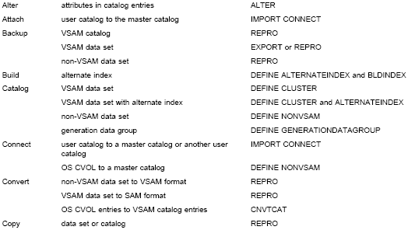
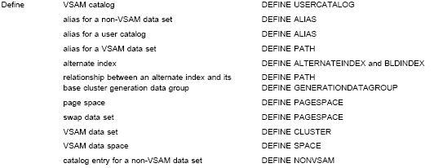
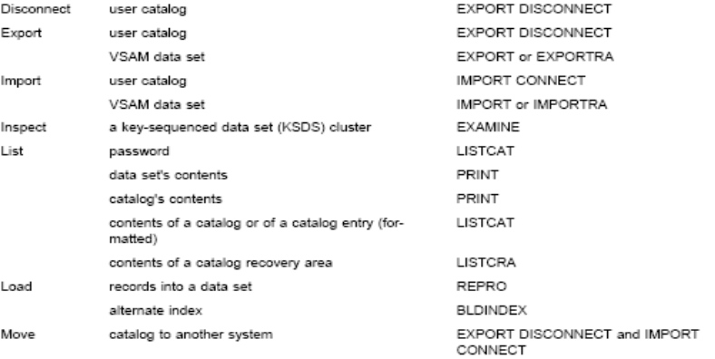
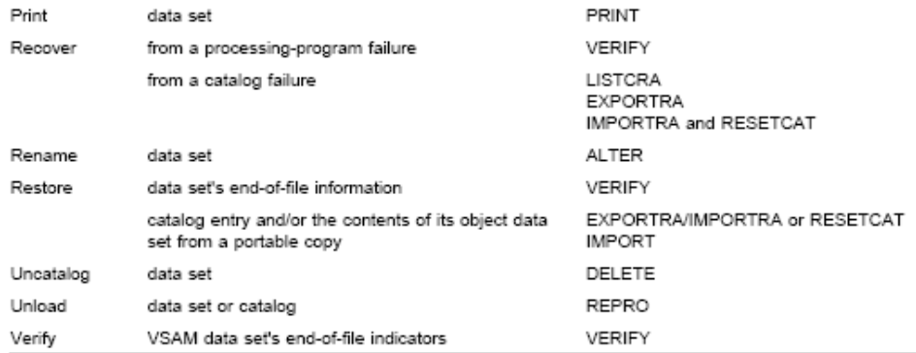
Examples of IDCAMS Commands

Slide 41
System Libraries
Take screenshot 2
z/OS has many standard system libraries, including:
  SYS1.PROCLIB JCL procedures distributed with z/OS
  SYS1.PARMLIB Control parameters for z/OS and some program products.
  SYS1.LINKLIB Many of the basic execution modules of the system.
  SYS1.LPALIB System execution modules that are loaded into the link pack area at z/OS initialization.
Notes:
These libraries are standard PDS data sets and are found on the system disk volumes.

Slide 42
Summary
Basic JCL contains three statements: JOB, EXEC, and DD.
A program can access different groups of data sets in different jobs by changing the JCL for each job.
New data sets can be created through JCL by using the DISP=NEW parameter.
Users normally use JCL procedures for more complex jobs. A cataloged procedure is written once and can then be used by many users.
z/OS supplies many JCL procedures, and locally-written ones can be added easily.
A user must understand how to override or extend statements in a JCL procedure to supply the parameters (usually DD statements) needed for a specific job.

Slide 43
Summary - continued
SDSF is a panel interface for viewing the system log and the list of active users and controlling and monitoring jobs and resources.
Utility programs make operating on data sets easier
System libraries contain JCL procedures, control parameters, and system execution modules.

